Slide 1

Code Organization
New Video File

Slide 2





Code Organization

Slide 3
Code Organization
HashiCorp Packer templates can be organized to strike a balance between readability and maintainability
As organizations use of Packer templates grows so does the importance of how to organize templates
Packer HCL provides flexibility in how templates can be organized
Notes:
We'll only be covering HCL in this course, though.

Slide 4
Load Order and Semantics
Packer configuration can be in a single file or split across multiple files. Packer will process all files in the current working directory which end in .pkr.hcl and .pkrvars.hcl
Sub-folders are not included (non-recursive)
Files are processed in lexicographical (dictionary) order
Any files with a different extension are ignored (e.g. .jpg or .pkr.old)
Generally, the order in which things are defined doesn't matter.
Notes:
With most programming languages, the order in which statements are defined matters. For instance, you can't use a variable until it's defined. Because of the way HCL works, the order in which things like sources, builders and variables are defined usually doesn't matter.

Slide 5
Load Order and Semantics
Parsed configurations are appended to each other, not merged
Sources with the same name are not merged (this will produce an error)
Configuration syntax is declarative, so references to other resources do not depend on the order they are defined
Notes:
In other words, you can define different parts of your build template in different files. At validate and build time, Packer will append these items together and treat them as a collective build template.

Slide 6
Which Files Does Packer Use?

Slide 7
Which of the following files would be parsed by Packer when a packer build command is issued?
Pop Quiz:

Slide 8


> tree . ├ README.md ├ ├ ├ packer.jpg ├ project │ ├ README.md │ ├ ubuntu.pkr.hcl
azure.pkr.hcl
aws.pkr.hcl

Slide 9
Teams choose to organize their configurations in many different patterns.
Organizational Patterns

Slide 10
Organizational Patterns
$ ls
main.pkr.hcl
variables.pkrvars.hcl

Slide 11
Organizational Patterns
$ ls
aws.pkr.hcl
azure.pkr.hcl
gcp.pkr.hcl
vmware.pkr.hcl
variables.pkrvars.hcl

Slide 12
Organizational Patterns
$ ls
ubuntu.pkr.hcl
windows.pkr.hcl
rhel.pkr.hcl
variables.pkrvars.hcl

Slide 13
Organizational Patterns
$ ls
everything.pkr.hcl

Slide 14
Build Options
# Validate & Build all items
# in a working directory
$ packer validate .
$ packer build .
# Specify an individual template
$ packer build aws.pkr.hcl

Slide 15
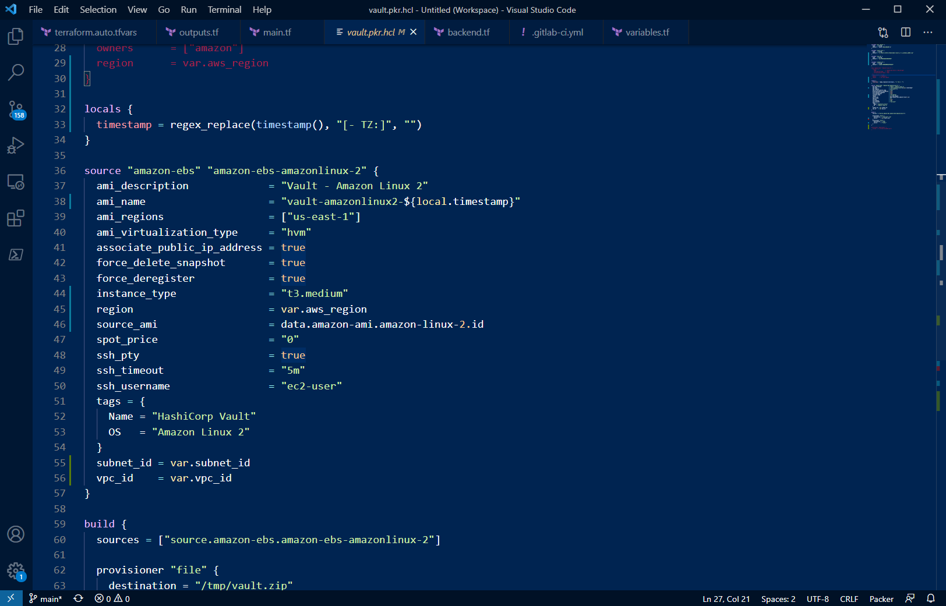
Syntax Highlighting
Plugins for Packer/HCL exist for most major editors, but Terraform tends to work best if one does not exist for Packer.
VSCode
Packer Syntax Highlighting

Slide 16

END OF SECTION

